Slide 1

CS 53D Intro To Computer Forensics
Tim Ryan
ryantimothy@fhda.edu

Slide 2
CS53D: Intro to Computer Forensics
Week 5 Agenda
Course and Assignment Review
Threat Intelligence Examples
Cyber News: Garmin Ransomware
Gmail Forensics
Google Drive & Earth Forensics
Final Exam Summary

Slide 3
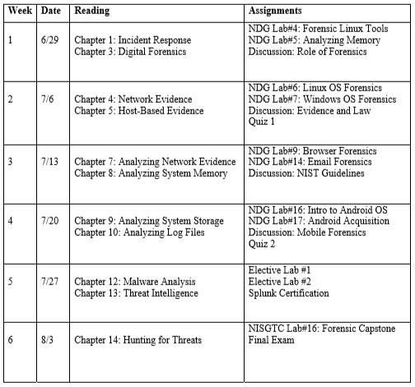
Course Outline
All Assignments Due Saturday, August 8th!

Slide 4
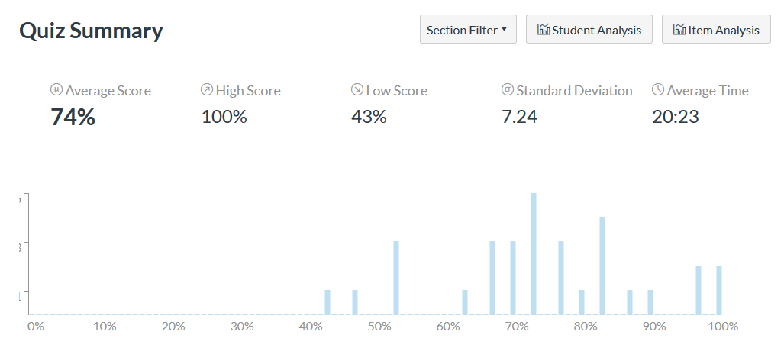
Quiz 2 Summary

Slide 5
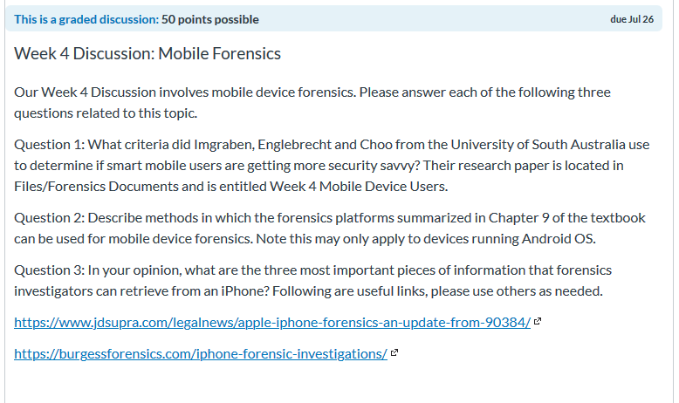
Week 4 Discussion, Great Responses

Slide 6
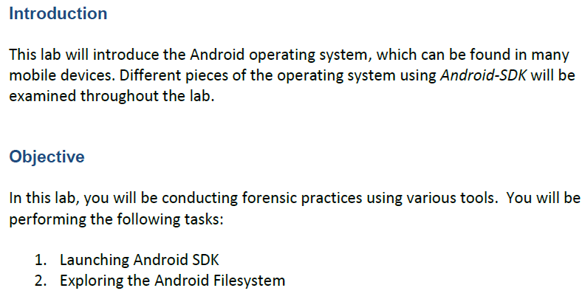

Slide 7
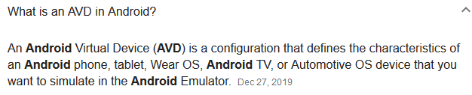
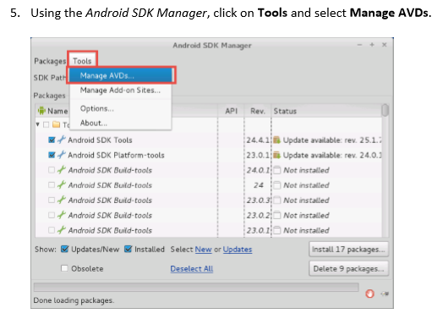

Slide 8
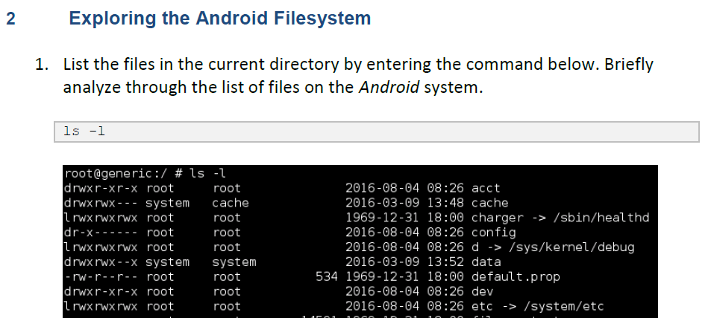
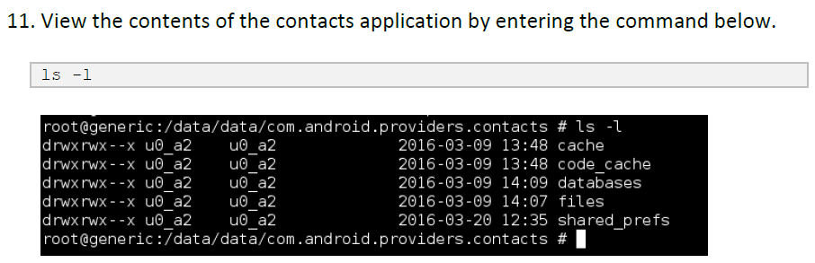

Slide 9
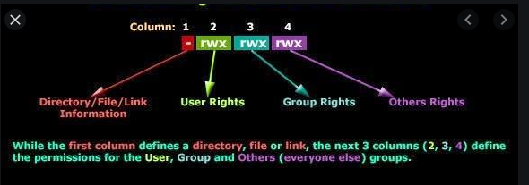
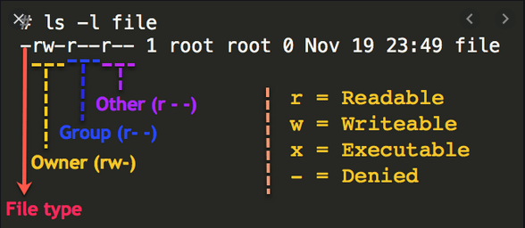
Linux File Permissions

Slide 10
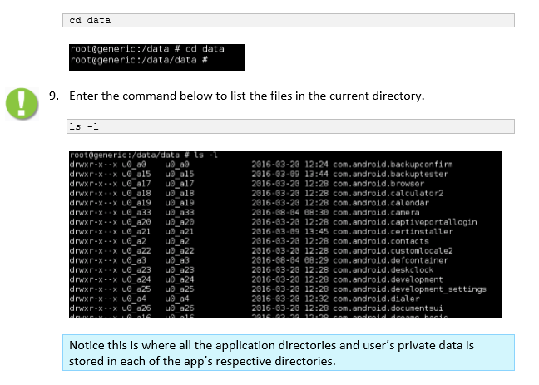

Slide 11
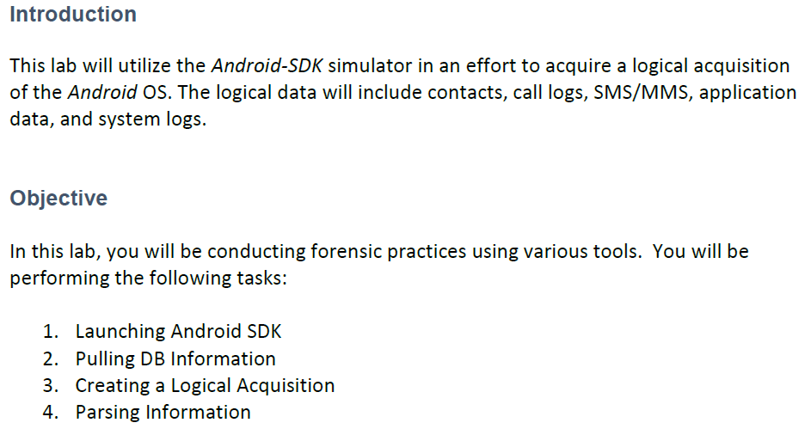

Slide 12
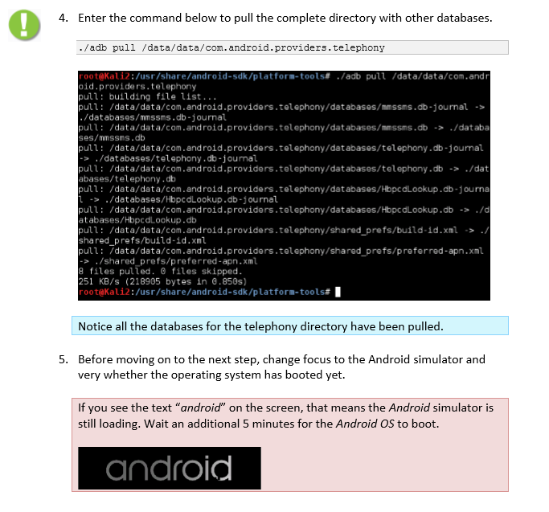

Slide 13
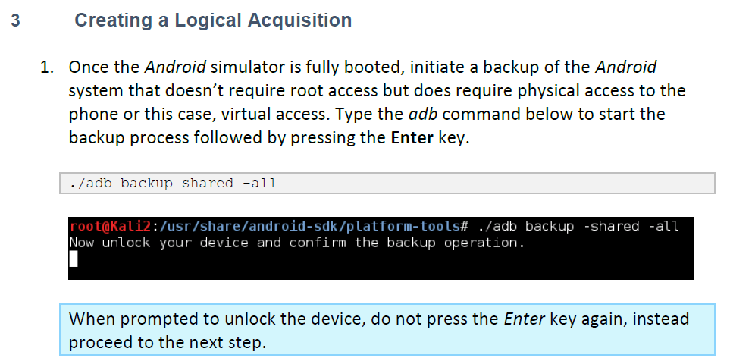
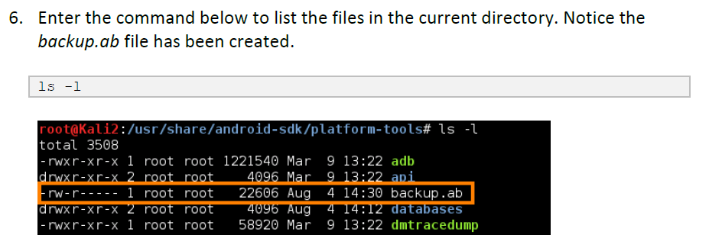

Slide 14
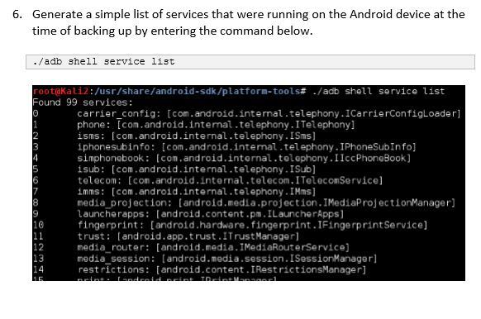

Slide 15
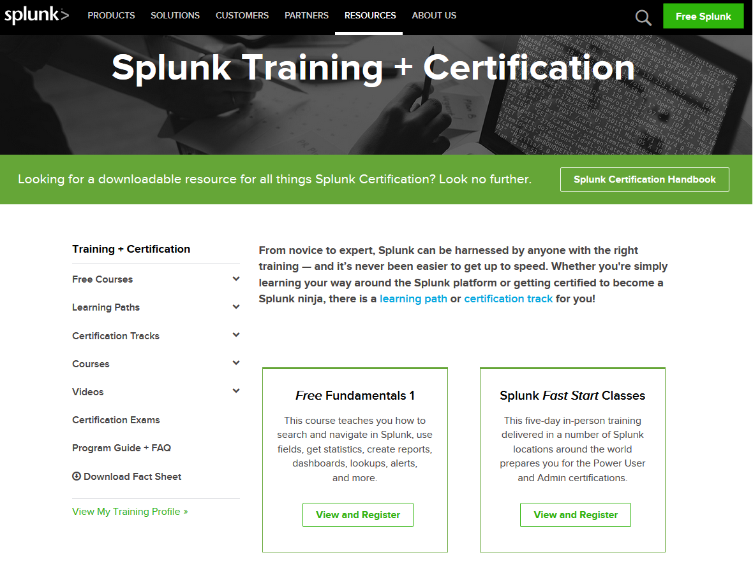
Week 5 Assignment
Common IT Forensics Tool
Source: https://www.splunk.com/en_us/training.html

Slide 16
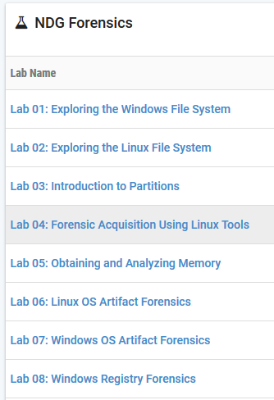
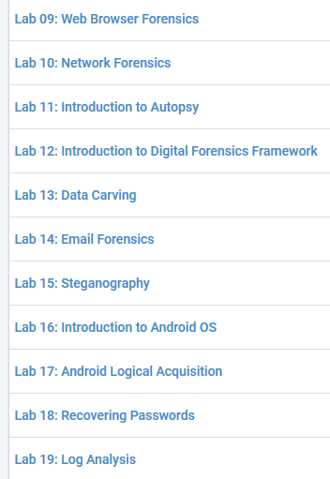
Elective and Extra-Credit Lab Options

Slide 17
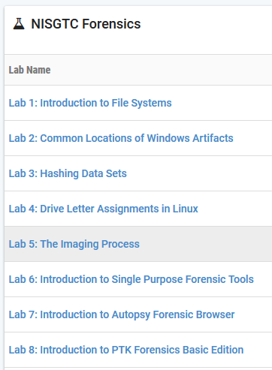
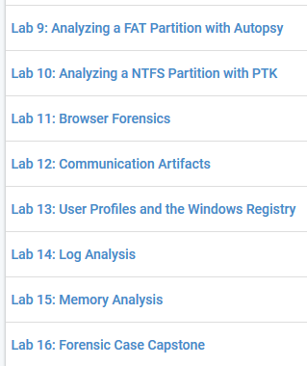
Elective and Extra-Credit Lab Options

Slide 18
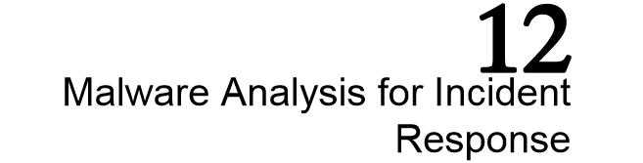
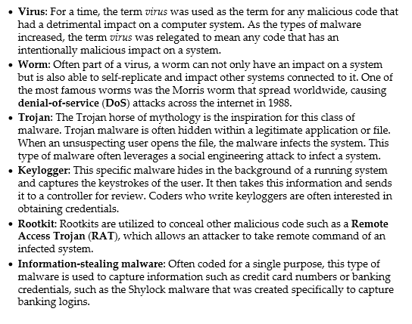

Slide 19
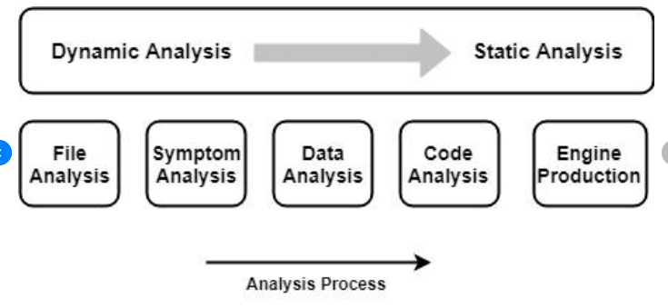
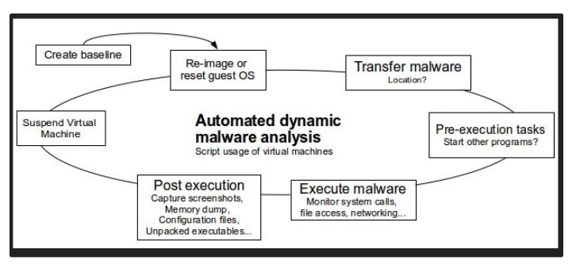
Malware Analysis Process

Slide 20
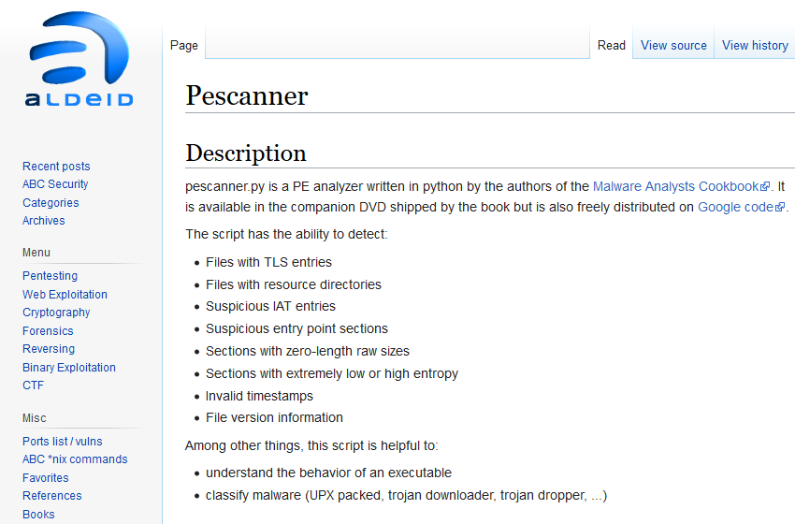
Source: https://www.aldeid.com/wiki/Pescanner

Slide 21
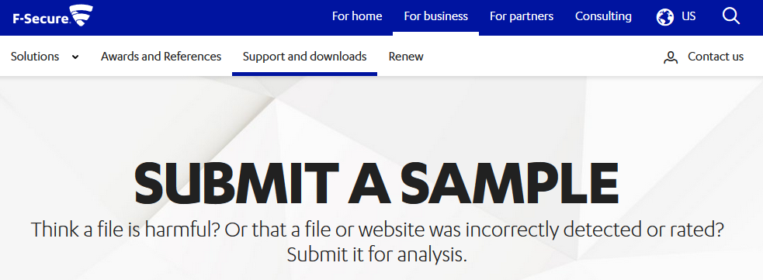
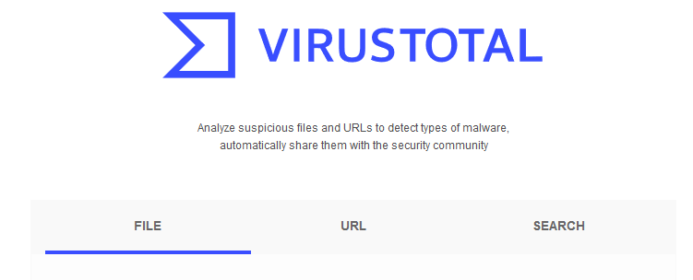
Malware Analysis Services

Slide 22
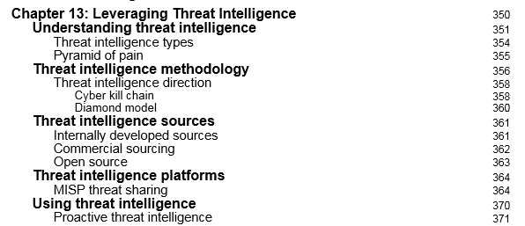
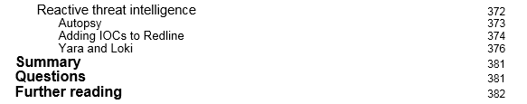
Chapter 13: Leveraging Threat Intelligence

Slide 23
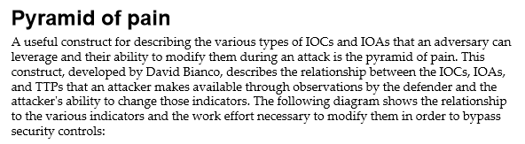
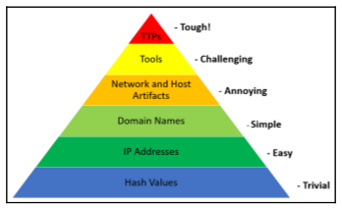
Tactics
Techniques
Procedures

Slide 24
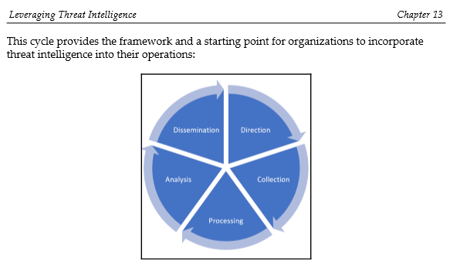

Slide 25

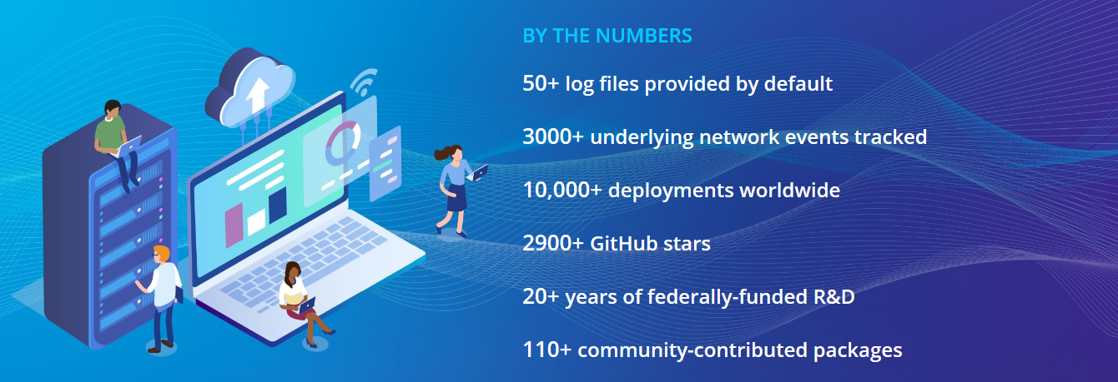
https://zeek.org/

Slide 26
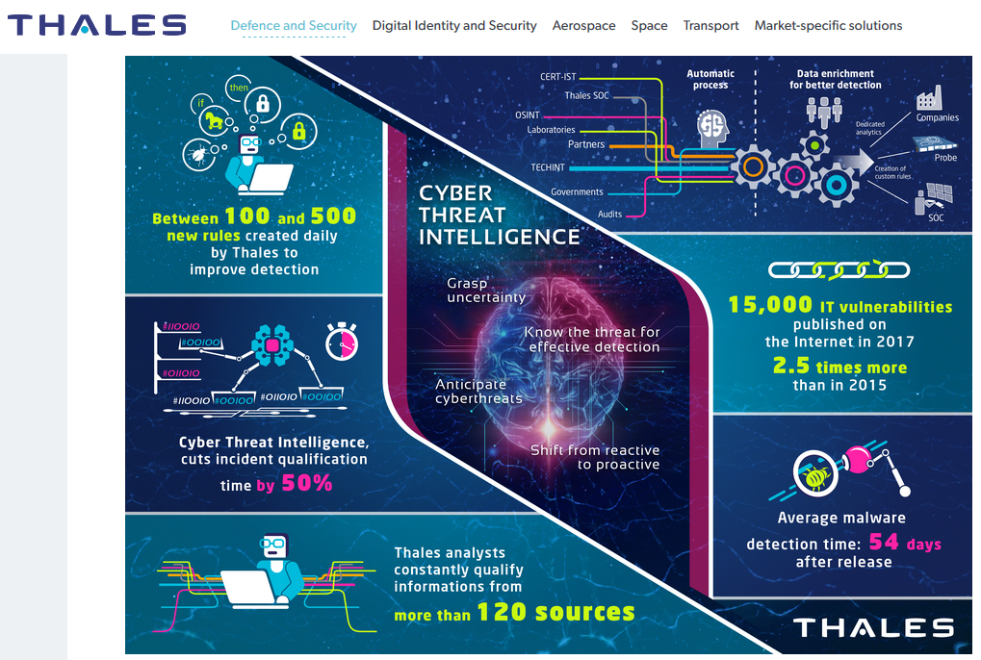
Source: https://www.thalesgroup.com/en/activities/security/critical-information-systems-and-cybersecurity/cyber-threat-intelligence

Slide 27
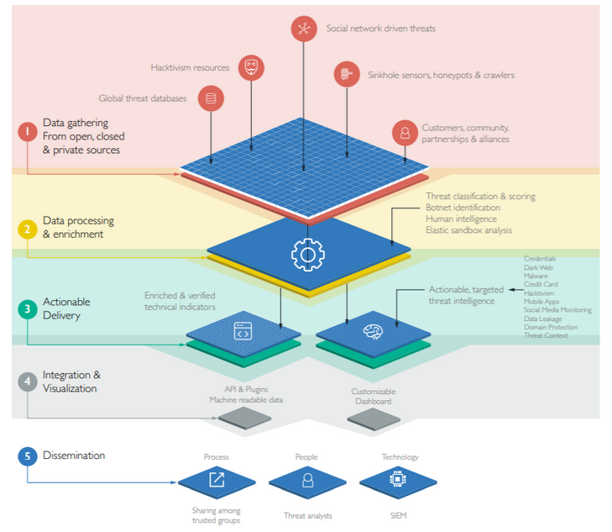
Source: https://www.blueliv.com/cyber-security-and-cyber-threat-intelligence-blog-blueliv/threat-intelligence/what-is-threat-intelligence/

Slide 28
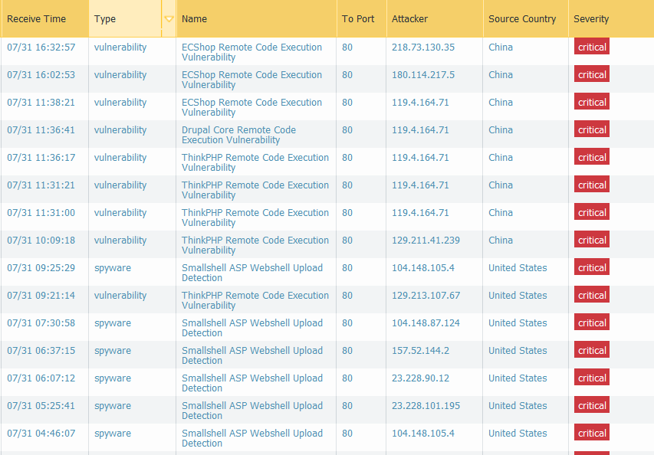
Firewall Critical Threats 2019

Slide 29
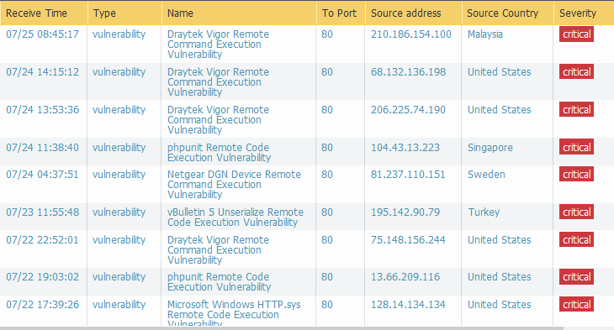
Firewall Critical Threats 2020

Slide 30
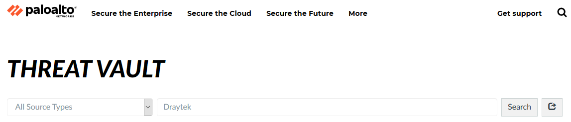
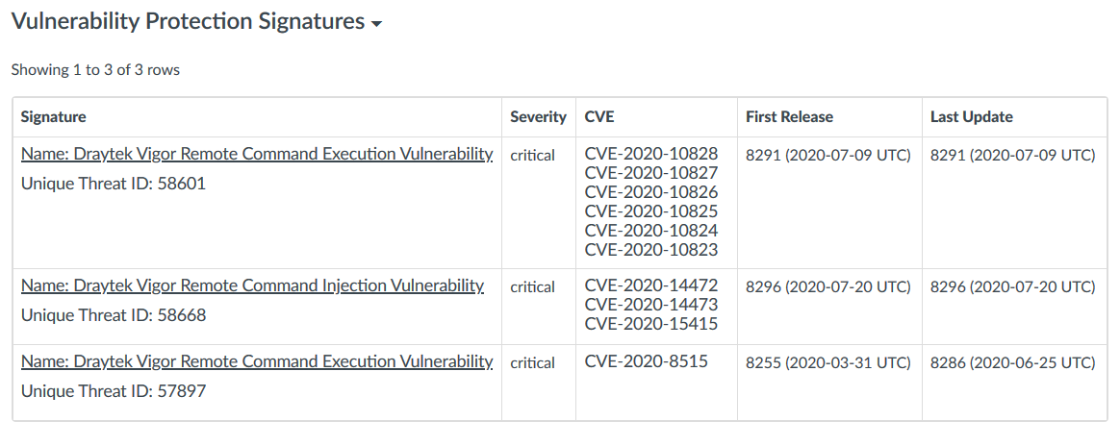

Slide 31
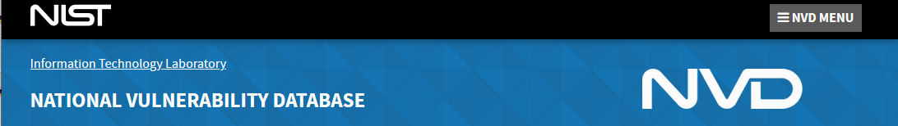
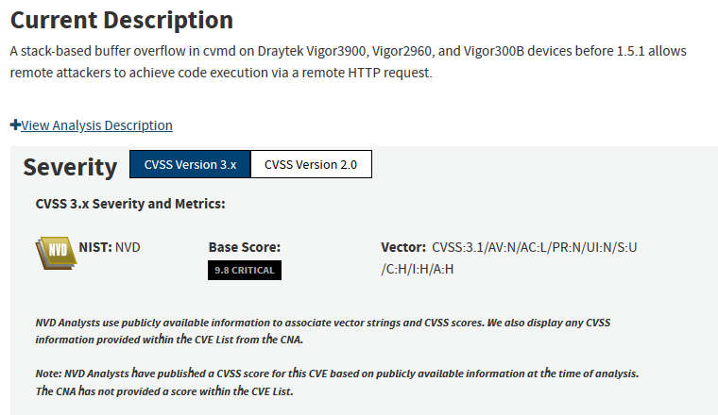

Slide 32
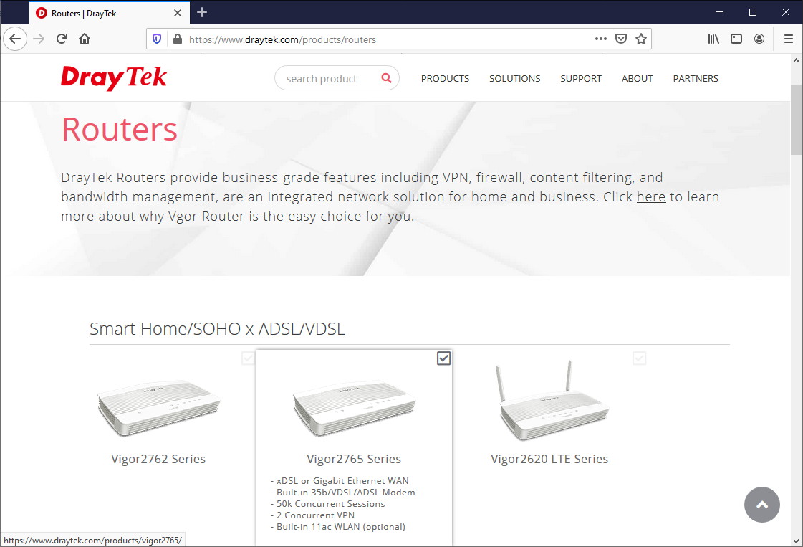
Forensics Task – Was This The Hacking Entry Point?

Slide 33
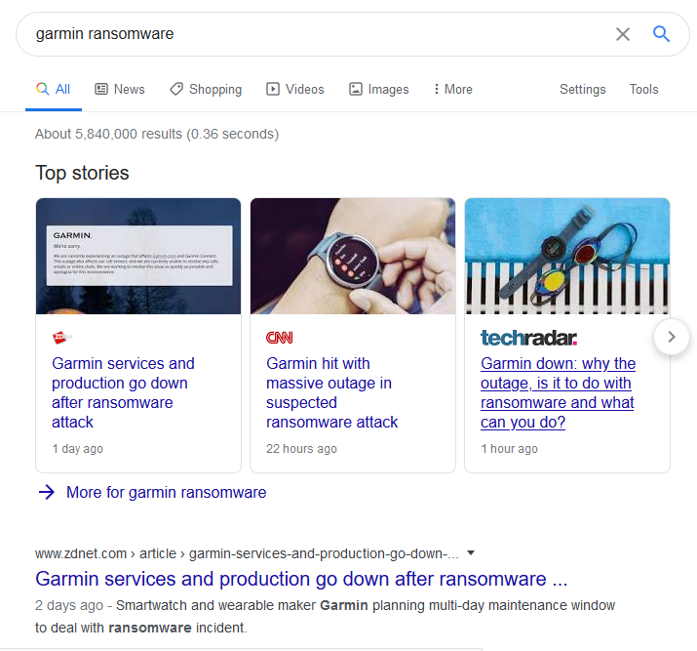
High-Profile Ransomware Attack

Slide 34
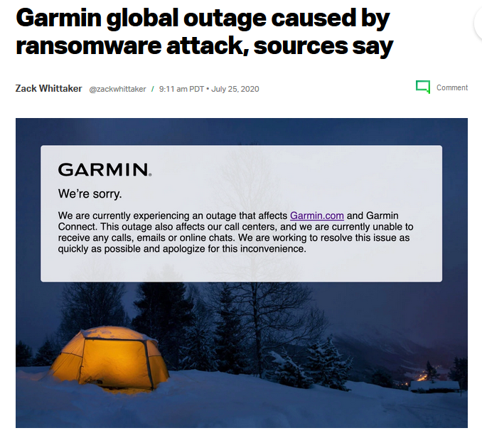
Source: https://techcrunch.com/2020/07/25/garmin-outage-ransomware-sources/

Slide 35
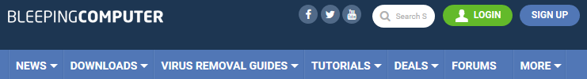
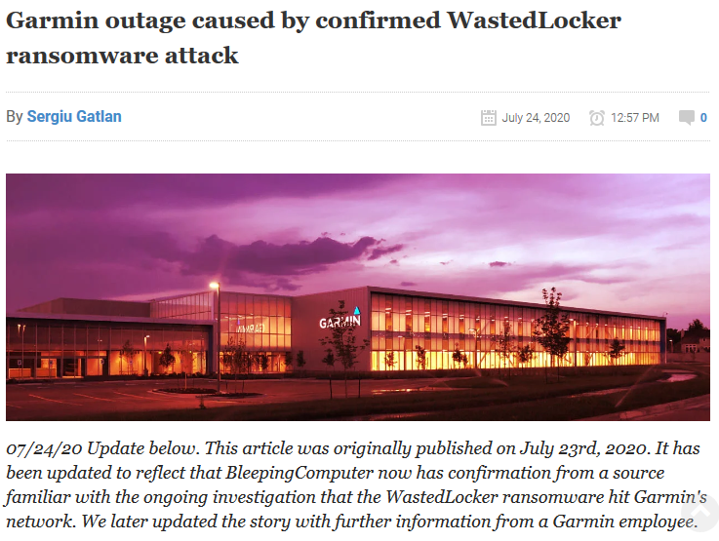
Source: https://www.bleepingcomputer.com/news/security/garmin-outage-caused-by-confirmed-wastedlocker-ransomware-attack/

Slide 36
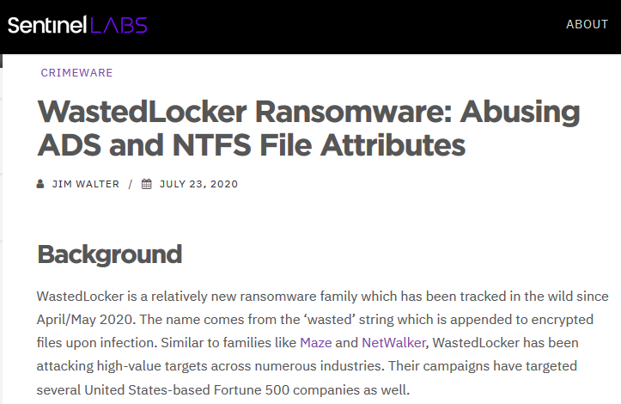
Source: https://labs.sentinelone.com/wastedlocker-ransomware-abusing-ads-and-ntfs-file-attributes/

Slide 37
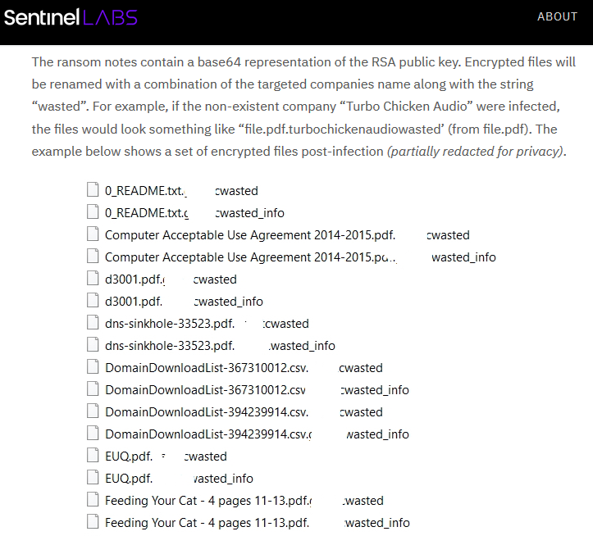
Forensics Task – What Are Ransomware Characteristics?

Slide 38
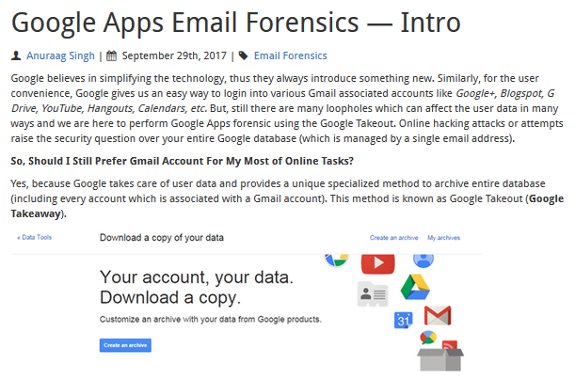
Source: https://www.dataforensics.org/google-apps-forensic/

Slide 39

Android to YouTube – TMI?
Source: https://takeout.google.com/settings/takeout

Slide 40

Start Time 10:52AM, Finish 12:45PM
Size ~ 6GB

Slide 41

Great For Investigators, Bad For Privacy

Slide 42

Source: https://cyberforensicator.com/2018/10/19/cloud-forensics-google-drive/

Slide 43


Slide 44


Slide 45

Source: https://searchsecurity.techtarget.com/feature/Google-Earth-Forensics-Using-Google-Earth-Geo-Location-in-Digital-Forensic-Investigations

Slide 46

GE and GPS Forensics

Slide 47


Slide 48

Foothill College GPS Coordinates
37.36N, -122.12W
Source: https://www.whatsmygps.com/

Slide 49

Google Maps – Right Click – What’s Here

Slide 50
Final Exam Summary
Multiple-Choice Question Topics:
Laws
Volatile Data
File Formats
Password Retention
Mobile Devices
Essay Question Topic:
Cloud Service Forensics

Slide 51

Final Lab Assigment

Slide 52


Slide 53


Slide 54


